Slide 1


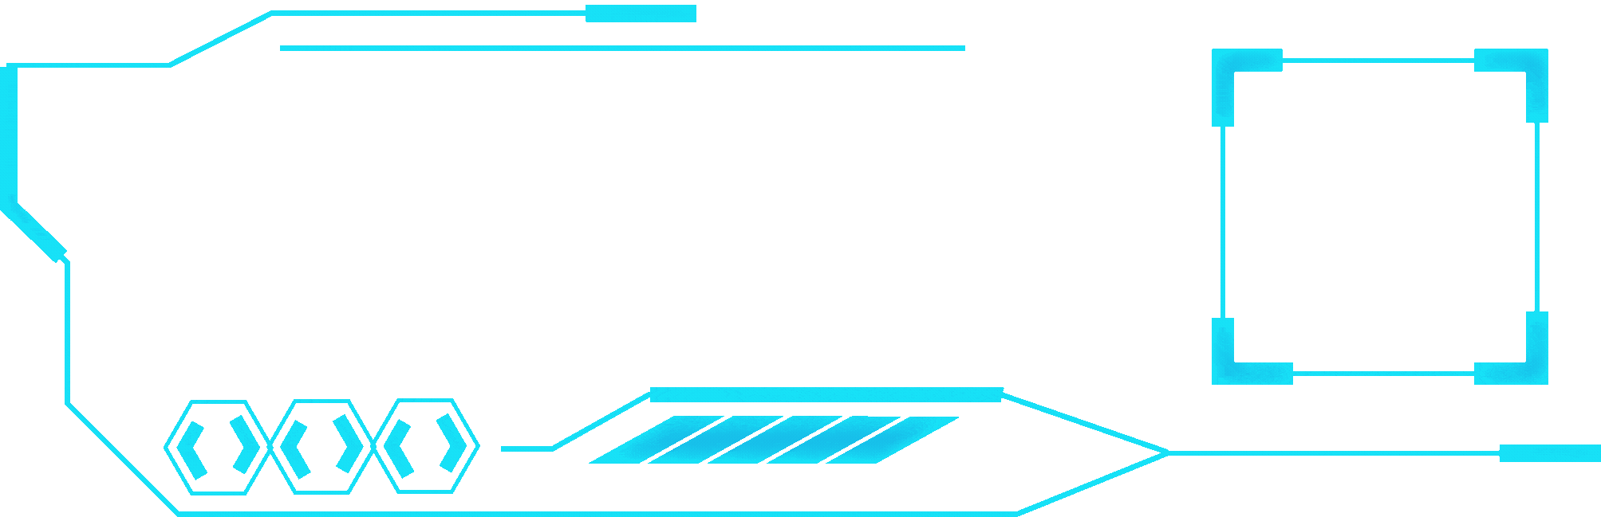


PATIENT CASE SIMILARITY
Leveraging Deep Learning for Disease Prediction

Slide 2



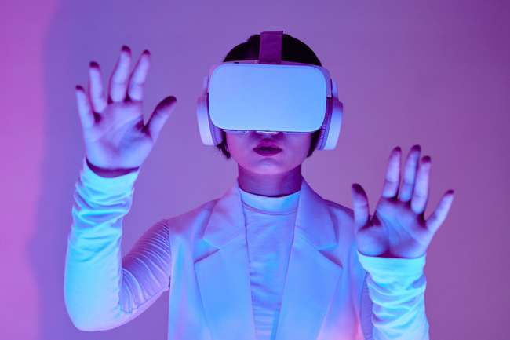
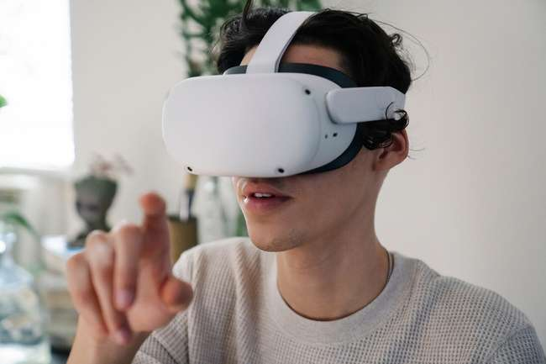
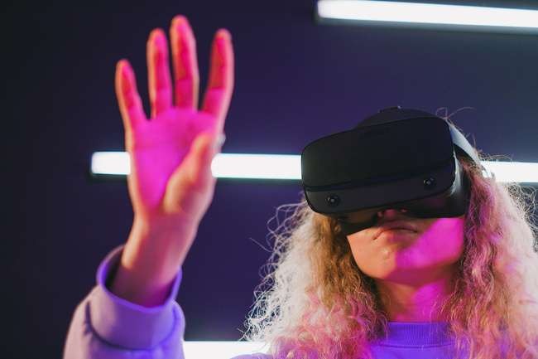

B.Tech in CSE ( Data Science )
MEET THE TEAM
Sanchita Goswami
Gaurav H
Srivatsa K S
Darshan M S
Umme Kulsum
www.patient case similarity.com

Slide 3


Patient Case Similarity
ABSTRACT
Automated disease classification using hybrid deep learning models (Attention Mechanism + BiLSTM).
Focus on symptom analysis through advanced NLP techniques.
Achieved cross-validation accuracy: 90.51%.
Utilized adaptive learning, class weight balancing, and multi-layer networks.
Aimed to bridge gaps between raw symptom data and accurate diagnostics.
www.patient case similarity.com

Slide 4


INTRODUCTION
Patient Case Similarity
1.
2.
3.
OVERVIEW
SIGNIFICANCE
MOTIVATION
AI-driven solutions for accurate and efficient disease diagnosis.
Combines BiLSTM and Attention Mechanism for feature extraction and sequential analysis.
Enhances diagnostic accuracy and reduces time.
Supports better patient outcomes with AI-driven tools.
Address limitations in traditional diagnostics.
Aligns with digital health trends and telemedicine.
www.patient case similarity.com

Slide 5

LITERATURE SURVEY
Patient Case Similarity
Reviewed research (2014-2024) on ML techniques for patient classification.
Algorithms: CNNs, RNNs, SVM, Random Forest.
Data representation: Medical records and numerical data.
Evaluation metrics: Accuracy, precision, recall, F1-score.
Identified gaps in existing methods for symptom-based disease classification.
www.patient case similarity.com

Slide 6

Patient Case Similarity
1.
Data acquisition challenges and privacy concerns.
High dependency on quality and volume of data.
Limited interpretability of deep learning models.
Integration issues with EHR systems for clinical use.
Need for supervision and decision support, not standalone diagnosis.
2.
RESEARCH GAPS
3.
4.
5.
www.patient case similarity.com

Slide 7

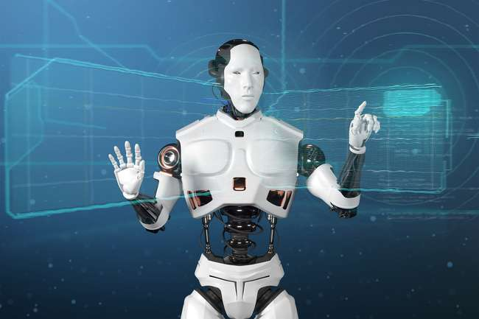
Hybrid Model:
Bidirectional LSTM + Attention for Patient Case Similarity
Architecture:
Embedding Layer (dim = 128) → Bidirectional LSTM → Custom Attention Layer → Dense Layers (ReLU) → Dropout Layer (rate = 0.4) → Output Layer (Softmax)
Key Techniques:
Bidirectional LSTM: Captures context in both directions.
Attention Mechanism: Focuses on relevant symptom features.
TF-IDF + Embedding: Combines statistical and learned representations.
Adam Optimizer: Efficient gradient-based learning.
Regularization: Dropout (40%) prevents overfitting.
Patient Case Similarity
PROPOSED METHODOLOGY
www.patient case similarity.com

Slide 8

Patient Case Similarity
OBJECTIVES
Develop a scalable, interpretable Attention -BiLSTM model for patient similarity detection.
Enhance patient care through case similarity insights.
Foster reproducibility and open-source methodology.
Align research with sustainable development goals (SDG 3, 9, 10).
www.patient case similarity.com

Slide 9

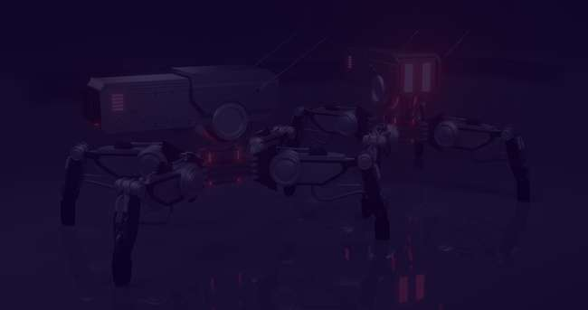
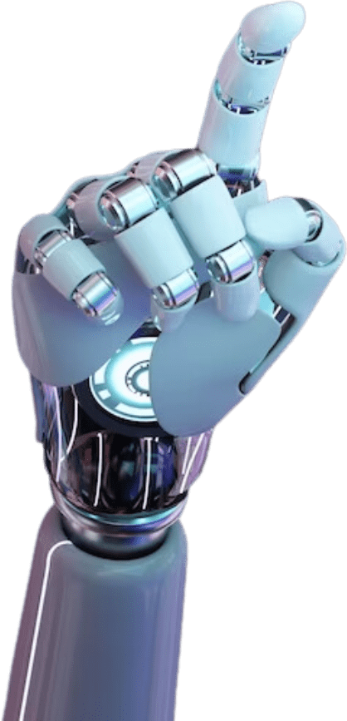
System Design & Implementation
Components:
Data Input, Preprocessing,
BiLSTM – Attention Processing, Output modules.
Pipeline:
Text preprocessing → Embedding → Sequential analysis → Prediction.
Optimization:
Model pruning, hyperparameter tuning, and cross-validation.
Deployment:
Cloud-based for scalability and efficiency.

Slide 10



Patient Case Similarity
Outcomes
Achieved final model accuracy: 90.51%.
Key findings:
> Effective temporal pattern recognition using
LSTMs.
> High impact of preprocessing on accuracy.
Use cases: Personalized medicine, clinical decision support, and drug discovery.
www.patient case similarity.com

Slide 11




Patient Case Similarity
Results & Discussions
Performance
Comparison
Challenges
Training accuracy - 92.3%,
Validation accuracy - 90.51%.
Training Loss: ~0.21
Validation Loss: ~0.28
Precision: ~ 88.7% (measuring true positives among predicted positives)
Recall: ~ 89.5% (measuring true positives among actual positives)
F1-Score: ~ 89.1%
Attention-BiLSTM outperforms SVM, k-NN, and traditional RNNs.
Data quality dependency and computational overhead.
www.patient case similarity.com

Slide 12


Patient Case Similarity
Conclusion
Successfully demonstrated the potential of Attention -BiLSTM for patient case similarity.
Highlighted the role of advanced text preprocessing and class balancing.
Future work:
> Integration with real-world clinical systems.
> Incorporate explainable AI for better adoption.

Slide 13


Patient Case Similarity
THANK YOU!
FOR YOUR ATTENTION
As we look to the future, these technologies will play a crucial role in shaping a better world for generations to come.
www.patient case similarity.com

